Slide 1
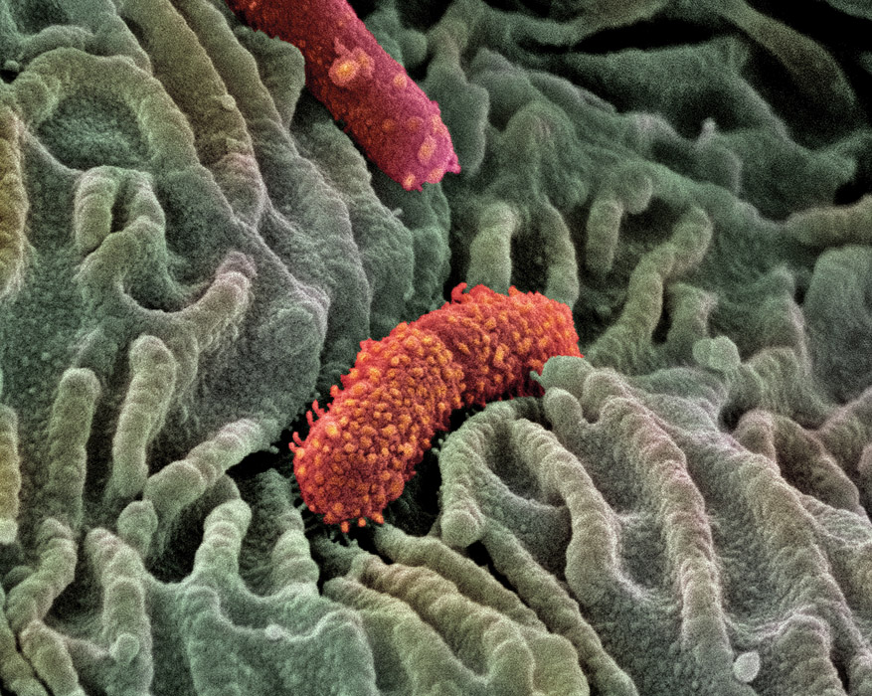
KEY CONCEPT Viruses exist in a variety of shapes and sizes.

Slide 2
Viruses
Living or non-living?
Generally are not considered living because:
Cannot reproduce on their own
Do not grow
Do not have homeostasis
Do not metabolize

Slide 3
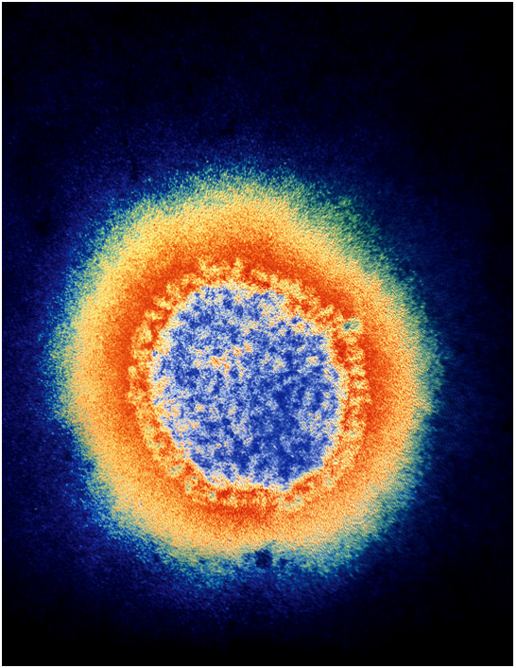
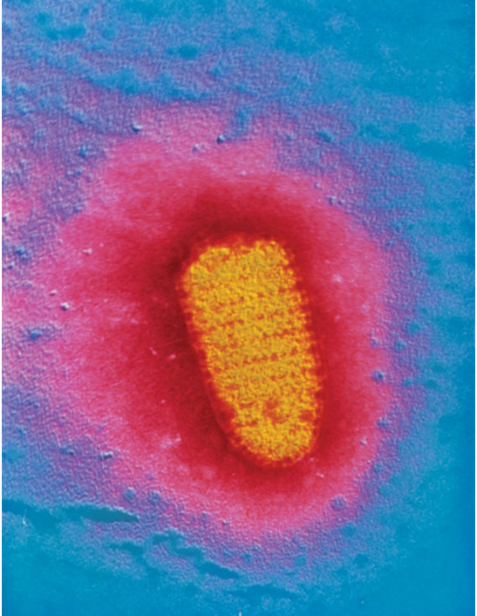
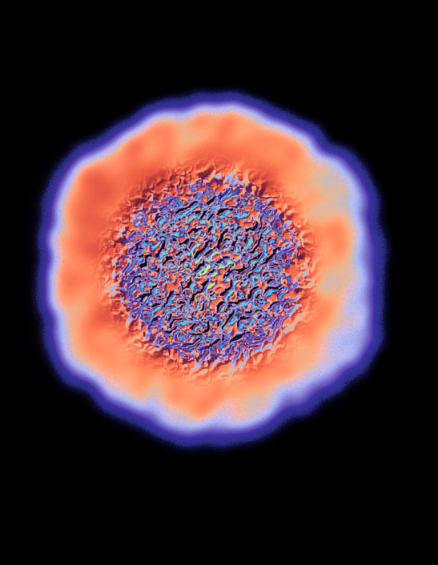
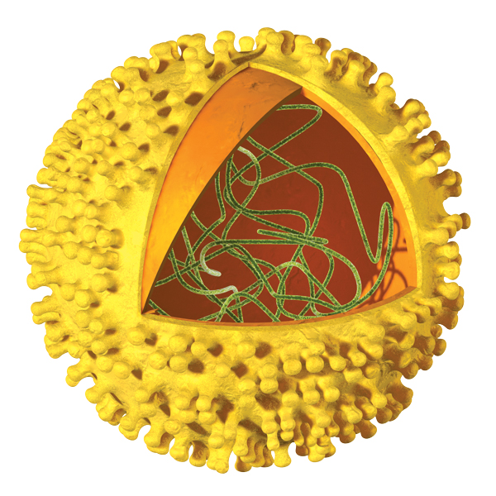
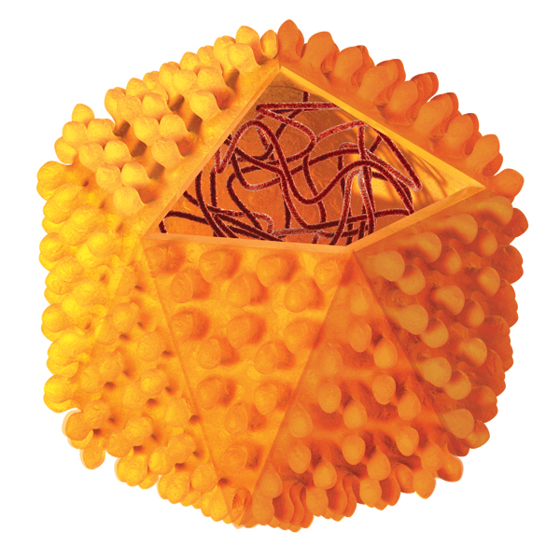
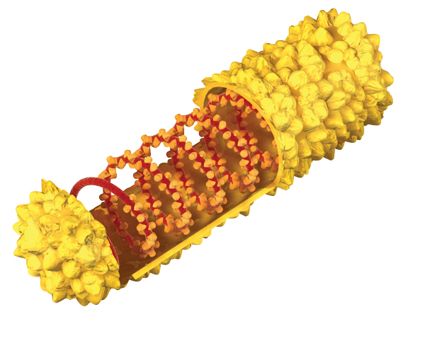
Viruses differ in shape and in ways of entering host cells.
Viruses have a simple structure.
genetic material
capsid, a protein shell
maybe a lipid envelope, a protective outer coat
enveloped (influenza)
helical (rabies)
polyhedral (foot-and-mouth
disease)
capsid
nucleic acid
Surface proteins
surface proteins
capsid
nucleic acid
lipid envelope
capsid
nucleic acid
surface proteins
lipid envelope

Slide 4
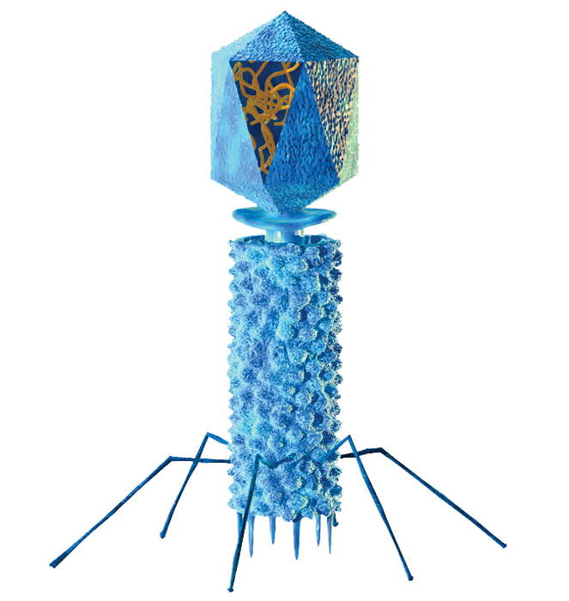
Bacteriophages (“bacteria eating”) infect bacteria.
capsid
DNA
tail sheath
tail fiber

Slide 5
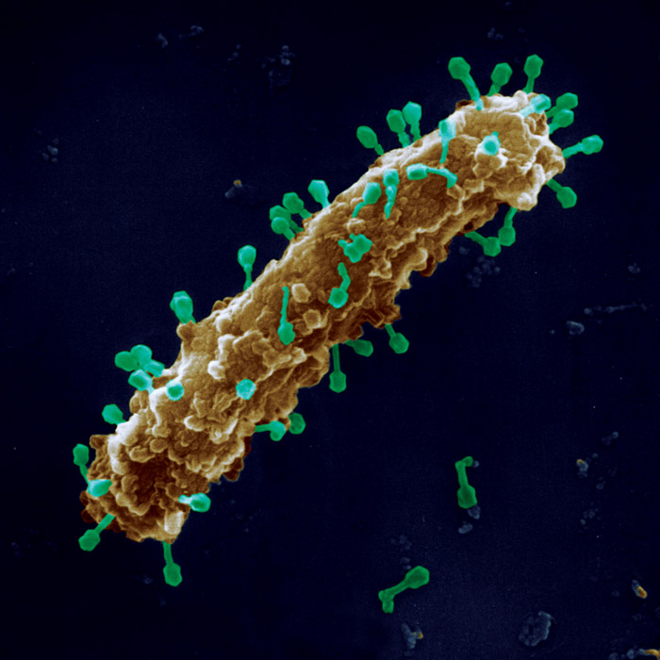
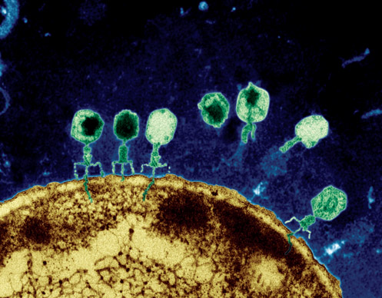
Viruses enter cells in various ways.
bacteriophages pierce host cells
colored SEM; magnifications:
large photo 25,000; inset 38,000x

Slide 6
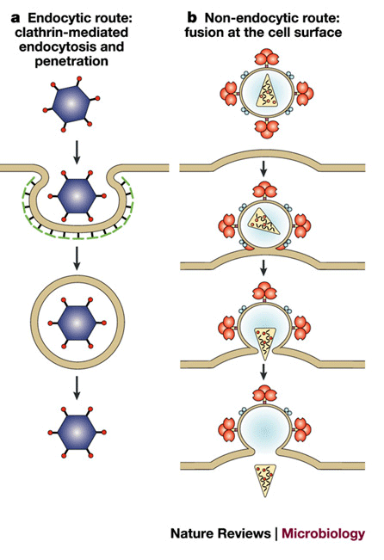
Viruses enter cells in various ways.
viruses of eukaryotes enter by endocytosis
(they are engulfed into the cell through the cell membrane)

Slide 7
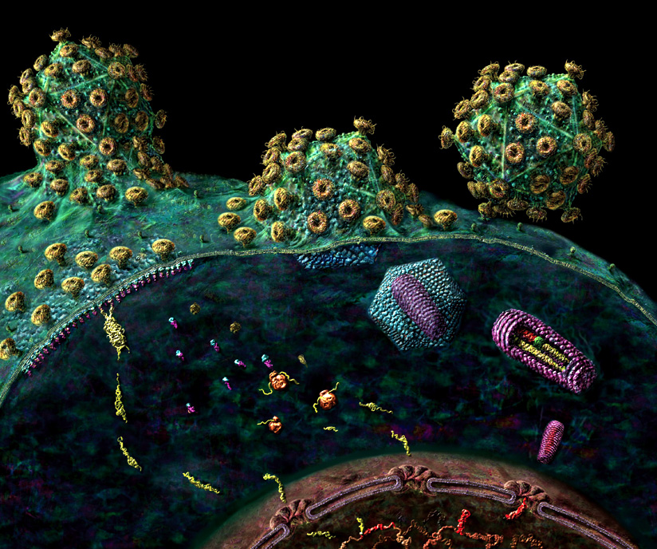
Viruses enter cells in various ways.
viruses of eukaryotes also fuse with membrane

Slide 8
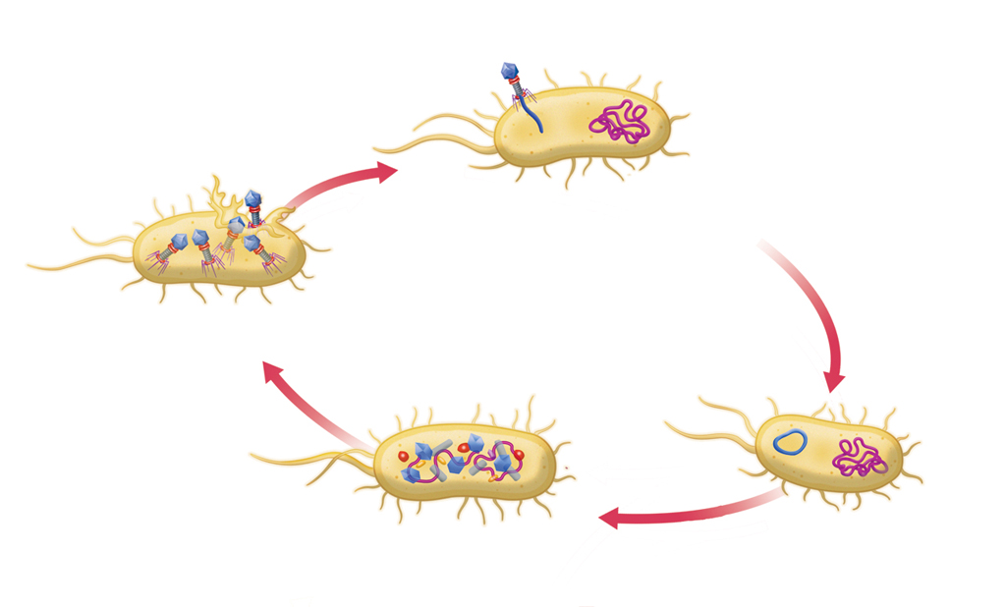
Viruses cause two types of infections.
A lytic infection causes the host cell to burst → killing host cell = sickness.
host bacterium
The bacterophage attaches and injects it DNA into a host bacterium.
The host bacterium breaks apart, or lyses. Bacteriophages are able to infect new host cells.
The viral DNA forms a circle.
The viral DNA directs the host cell to produce new viral parts. The parts assemble into new bacteriophages.
The virus may enter the
lysogenic cycle, in which the
host cell is not destroyed.

Slide 9
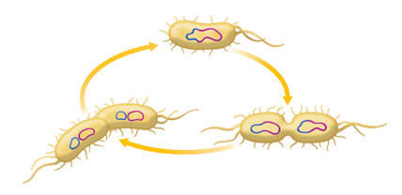
A lysogenic infection does no immediate harm.
The prophage may leave the
host’s DNA and enter the
lytic cycle.
The viral DNA is called a prophage
when it combines with
the host cell’s DNA.
Although the prophage is not
active, it replicates along with
the host cell’s DNA.
Many cell divisions produce a
colony of bacteria infected
with prophage.

