Slide 1
Fungi: Yeast
Microorganisms Unit
Ms. Raynor, MHS Biology

Slide 2
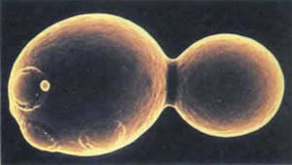
Kingdom Fungi
Fungi can be single-celled or many-celled
Heterotrophic – cannot make their own food
Reproduce both sexually or asexually
Form spores
Make new cells by budding

Slide 3
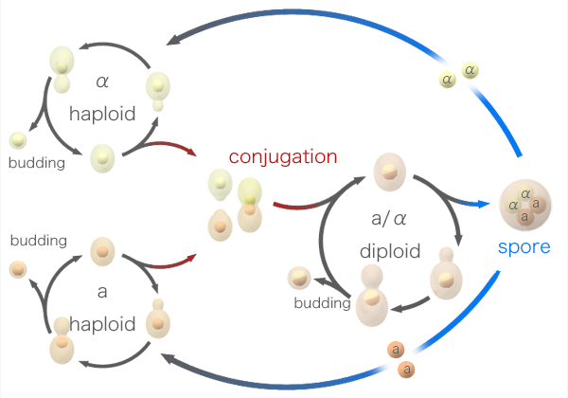
Fungi Reproduction

Slide 4
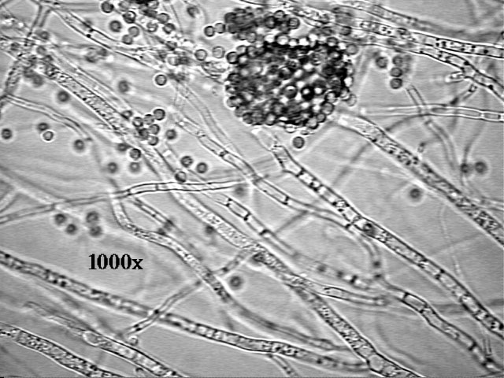
Structure
The green and white fuzz of mold is actually the reproductive structures of the fungus
The body of the fungus is within the food
All fungi except yeasts have hyphae
Long filaments

Slide 5
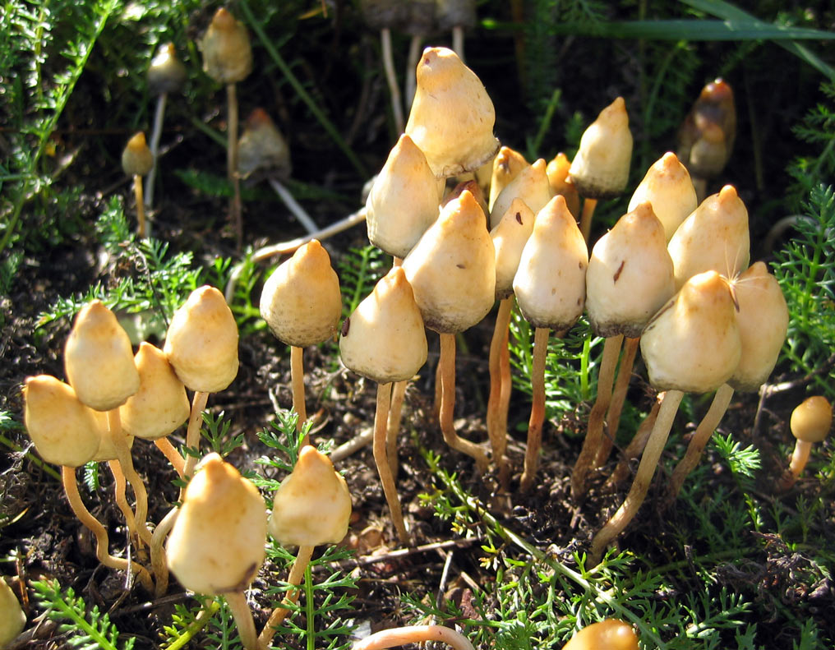
Decomposers
Secrete digestive enzymes that break down organic matter
Absorb nutrients for their own use
Ex. Athlete’s Foot – breaks down skin cells causing red, itchy areas
Decompose leaves, branches, dead animals and waste

Slide 6
Benefits vs. Detriments
Benefits
Detriments
Baking
Brewing
Wine-making
Cheese production
Flavor
Eating
Antibiotics
Mold
Athlete’s Foot (Tinea pedis)
Ringworm
Thrush/Candidiasis
Pneumonia
Fungemia

Slide 7
History of Yeast
Hieroglyphics indicate that Ancient Egyptians were using live yeast and fermentation to make their bread rise over 5,000 years ago.
Leaven was a soft, dough-type medium kept from one bread baking session to another. A small portion of this dough was used to start or leaven each new lot of bread dough.
Leavening mixtures for bread making were formed by natural contaminants in flour such as wild yeast and lactobacilli (which are what?)
Yeast reproduces so quickly that it has evolved into a completely different form than 100 years ago and will continue to do so.

Slide 8
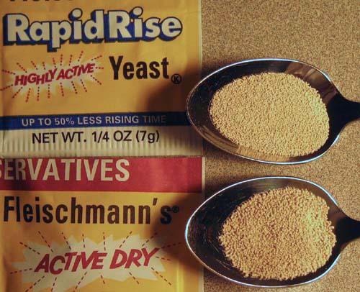
Yeast
1,500 species have been identified
This is estimated to be only 1% of the actual number of species
Saccharomyces cerevisiae “Sugar-eating Fungus”
Baker’s yeast
Candida albicans
Causes thrush
Naturally occurs
On your skin,
On the skins of many fruits and berries
In the gut flora of some mammals and insects

Slide 9
The End.
Homework:

