Slide 1
Genetics & Probability
Mendel’s laws:
  Law of Segregation: you get one allele for a trait from Mom and one allele from Dad
  Law of Independent Assortment: the inheritance of one trait has no effect on the inheritance of another
reflect same laws of probability that apply to tossing coins or rolling dice

Slide 2
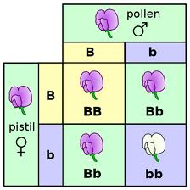
Punnett Squares

Slide 3
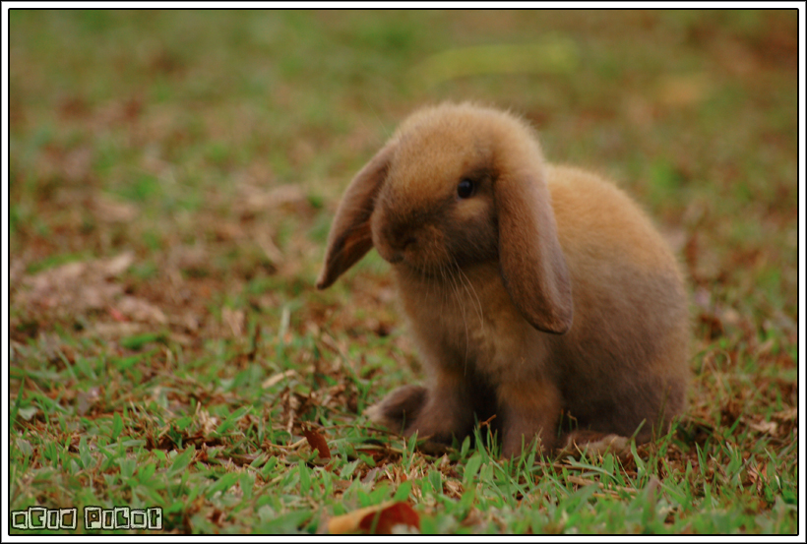
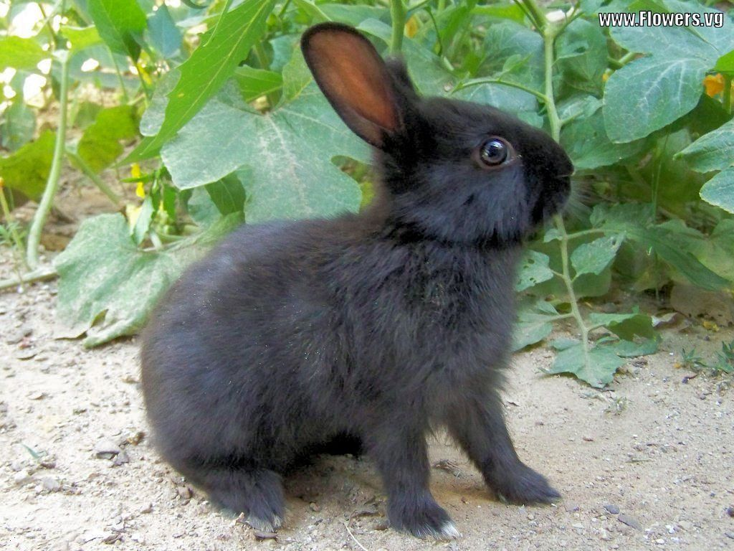
b
b
B
B
b
B
b
When we say “cross” we mean mate.
b
b
b
b
b
Punnett Square: a diagram used to predict what the offspring might look like.
Example
A black rabbit with genotype Bb is crossed with a brown rabbit genotype bb.

Slide 4
Genotypic Ratio: When we show all of the possible genotypes from a Punnett square
Always written in the order:
Homozygous Dominant: Heterozygous : Homozygous Recessive
D
d
D
D
D
D
d
How many are there?
____ : ____ : ____
DD Dd dd
1
2
1
d
D
d
d
d

Slide 5
Phenotypic Ratio: When we show all of the possible phenotypes from a Punnett square
Always write in the order:
Dominant Phenotype : Recessive Phenotype
D
d
D
D
D
D
d
How many are there?
____ : ____
Dominant Recessive
3
1
d
D
d
d
d

Slide 6

Probability & Genetics
Probability is useful in genetics because it allows us to:
  Predict possible genotypes for offspring
  Predict the traits of the offspring produced when two individuals mate (genetic cross)

Slide 7
Watch me complete one:
Free Hanging Earlobes (E) and Attached Earlobes (e)
E
e
E
e
Mom has free hanging:
Dad has free hanging:
All possible Genotypes:
EE
Ee
ee
Genotypic Ratio: EE:Ee:ee
1:2:1
What percent of the offspring are:
Phenotypic Ratio: Free:Attached
3:1
Homozygous Dominant?

Slide 8
With the completed Punnett Square we can predict the traits and genotypes of the offspring
All possible Genotypes:
EE
Ee
ee
25%
25%
EE
Ee
25%
25%
Ee
ee
What percent of the offspring have Free Hanging Ear lobes?
75%
What percent of the offspring are homozygous recessive?
25%

Slide 9
Lets do this one together:
Widows peak (W) is dominate to no peak (w)
Mom has a peak: WW Dad does not: ww
All possible genotypes
Genotypic Ratio:
Phenotypic Ratio:

