Slide 1
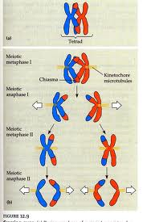
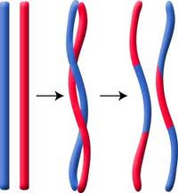
Crossing Over

Slide 2
Crossing Over
Today’s Objective
CT Science Standard D36: Explain how meiosis contributes to the genetic variability of organisms

Slide 3
Crossing Over
Linkage - The genes for some traits are found on the same chromosomes.
Brown eye allele
Blue eye allele
This means… two genes that are linked are always going to be inherited together
Brown hair allele
Blonde hair allele
Mom’s C’some
Dad’s C’some

Slide 4
Crossing Over
Crossing over is when two homologous chromosomes swap some of their DNA to create two new chromosomes.

Slide 5
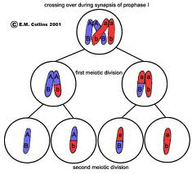
Crossing Over- When and how
Crossing over occurs during prophase I of meiosis when the homologous chromosomes match up.

Slide 7
Crossing Over- Importance of
Crossing over is important because it increases the likelihood that genes will not stay linked together.
Therefore crossing over increases genetic diversity.

