Slide 1
Enzymes
& Chemical Reactions

Slide 2
Chemical Reactions
Bonds break or form during a chemical reaction
Bond energy is the amount of energy that breaks a bond.
Energy is added to break bonds
Energy is released when bonds form
Reactants
Product
2H₂ + O₂ → 2H₂O
Notes:
Physical change vs. chemical change
Some reactions release energy, some absorb energy to break and form bonds
Metabolism = all chem reactions in organism
Single reactions often happen as part of larger series

Slide 3
Chemical Reactions
6O₂ + C₆H₁₂O₆ 6CO₂ + 6H₂O
REACTANTS
Reactants are changed during a chemical reaction.
PRODUCTS
Products are made by a chemical reaction.

Slide 4
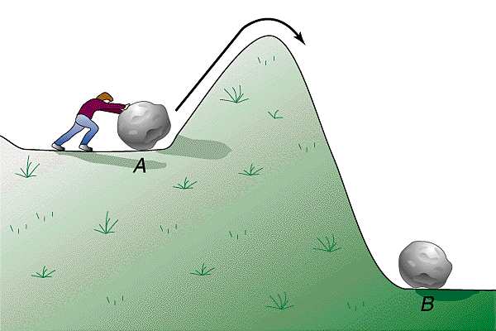
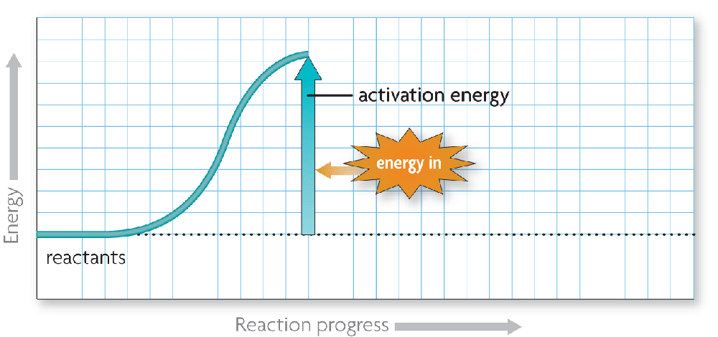
Activation Energy
Chemical reactions release or absorb energy.
Activation energy: amount of energy that needs to be absorbed to start a chemical reaction.
Energy is needed to start reactions!
Notes:
Like rolling boulder down a hill – need to push it first…

Slide 5
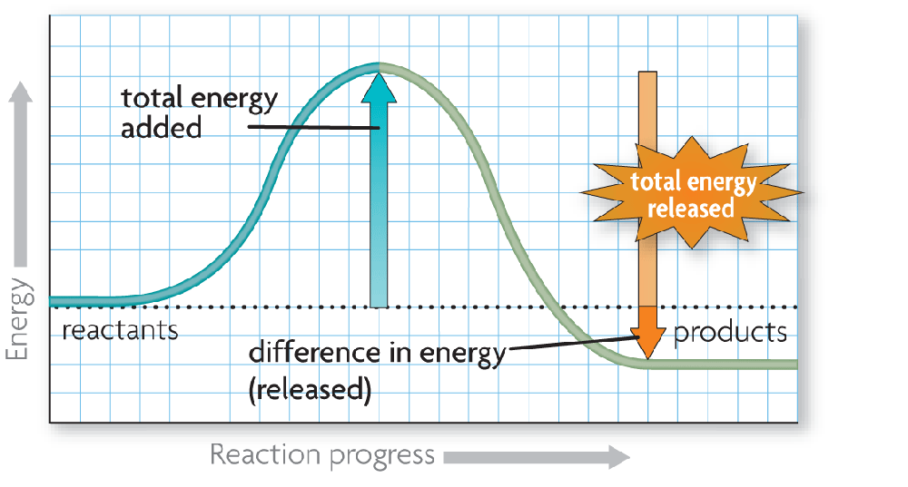
Exothermic Reactions
Exothermic reactions release more energy than they absorb.
Reactants have higher bond energies than products.
Excess energy is released by the reaction.

Slide 6
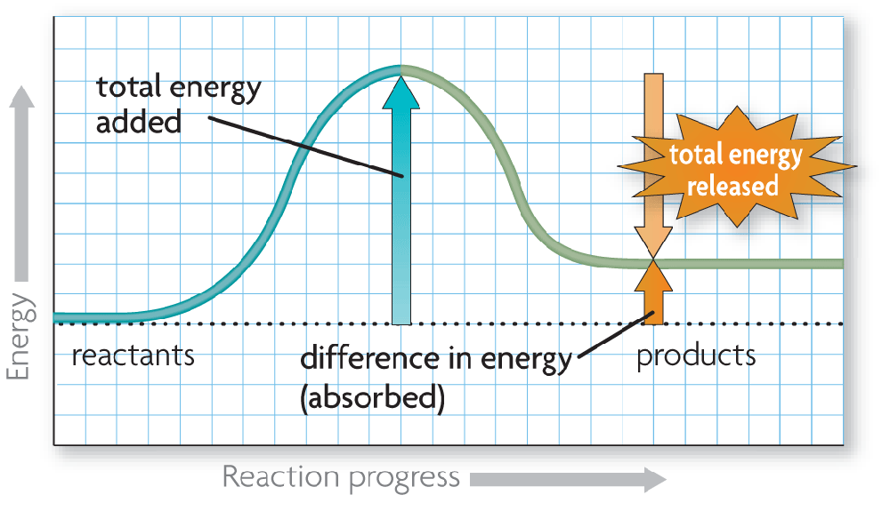
Endothermic Reactions
Endothermic reactions absorb more energy than they release.
Reactants have lower bond energies than products.
Energy is absorbed by the reaction to make up the difference.

Slide 7
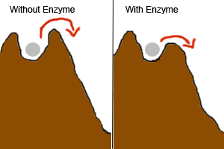
Rates of Reactions
Enzymes are catalysts!
Catalysts affect the reactions in living cells by changing the speed of the reactions.
Catalysts increase the rate of chemical reactions:
Reactants can combine easily
Reactions happen FASTER!!
Notes:
low rate – slow
high rate – fast
Depends on type of molecules combining
Collision Theory – more collisions, more likely reactions will happen
what would make more collisions?
concentration (increase = more molecules in a space, more likely to hit each other)
temperature (increase = molecules moving around quicker, more likely to hit each other)
pressure (increase pressure = less space to move, molecules hit each other more often)

Slide 8
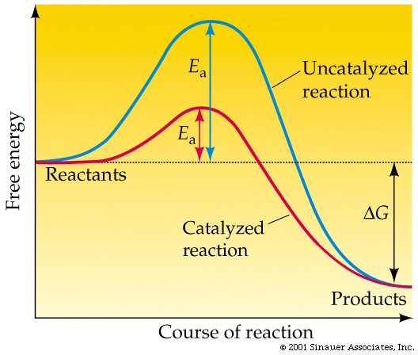
Notes:
Catalysts can:
help molecule shift structure
make two molecules combine, releases a lot of energy and energy might help another reaction

Slide 9
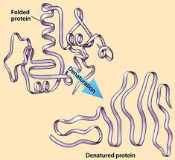
Enzyme Activity
Enzymes work best at specific temperatures and pH
Notes:
Anything that changes the shape of an enzyme can affect the activity
Conditions that affect bonds will affect shape

Slide 10
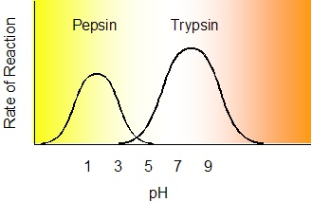
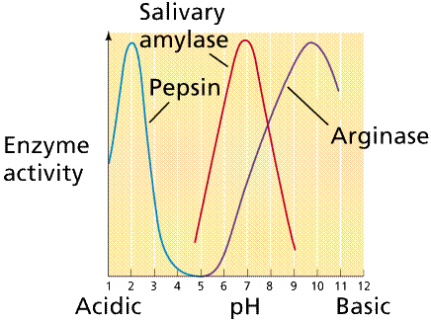
Notes:
Salivary amylase – breaks down sugars (starch to glucose)
located in mouth
Pepsin – works in stomach (proteins)
Trypsin – intestine (proteins)
Arginase – liver (makes urea)

Slide 11
Application Question
Someone who has Cystic Fibrosis, causes, among other things, a deficiency in pancreatic enzymes. These enzymes help fat and protein molecules to be broken down and stored properly. Before every meal or snack, she or he has to take “enzymes.”
What would happen if she or he did not take these enzymes?
Notes:
Cystic fibrosis – mutation to a gene in charge of making components of sweat, mucus, and digestive enzymes

