Slide 1
KEY CONCEPT Pathogens are organisms or substances that cause illness ex. Viruses, bacteria, fungi, protozoa

Slide 2
Two Types of Cells
Prokaryotes
Ex) Bacteria, single celled organisms
Simpler & smaller cells
Do NOT have organelles
DO have DNA/ RNA
Eukaryotes
Ex) Plant & animal cells
More complex
Have organelles ex) mitochondria, nucleus, ribosomes, etc
Have DNA/RNA

Slide 3
Two types of Bacteria
Bacteria have existed for 3.5 billion years and are the most ancient and diverse form of life on Earth.
Archeabacteria
Eubacteria
Many Live in harsh environments that we believed to be lifeless.
Ex. Extremely acidic environments, excessive temperature exceeding 400 degrees.
The most common type of bacteria.

Slide 4
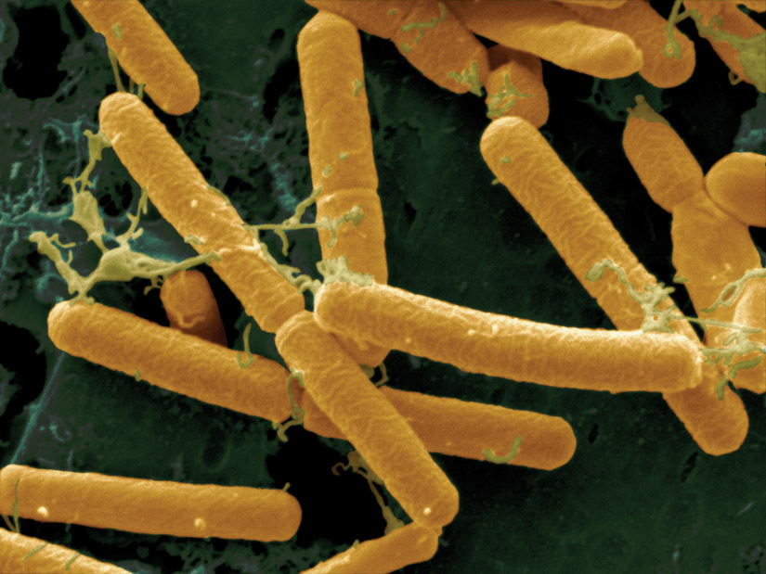
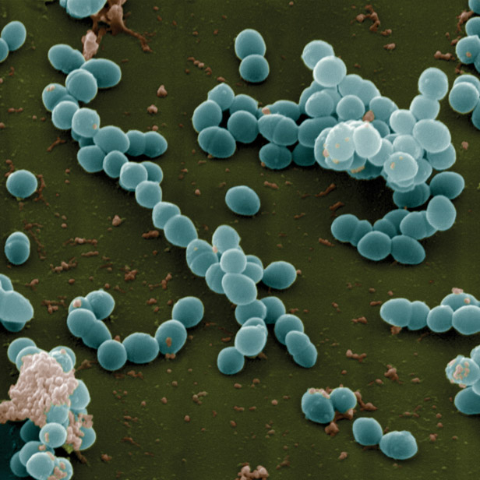
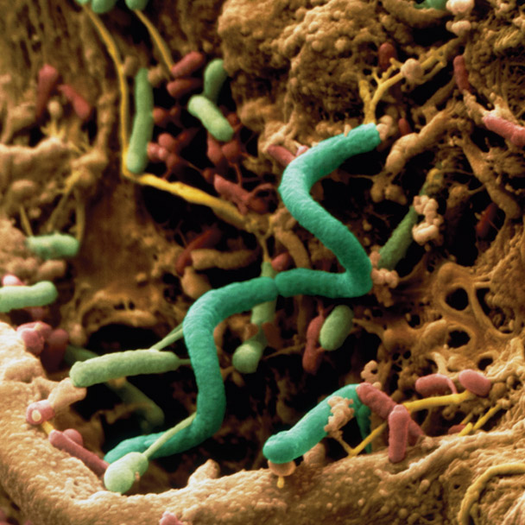
Bacteria and archaea are structurally similar but have different molecular characteristics.
Bacteria commonly come in three forms.
rod-shaped, called bacilli
spiral, called spirilla or spirochetes
spherical, called cocci
Lactobacilli: rod-shaped
Spirochaeta: spiral
Enterococci: spherical
Archaea have many shapes.

Slide 5
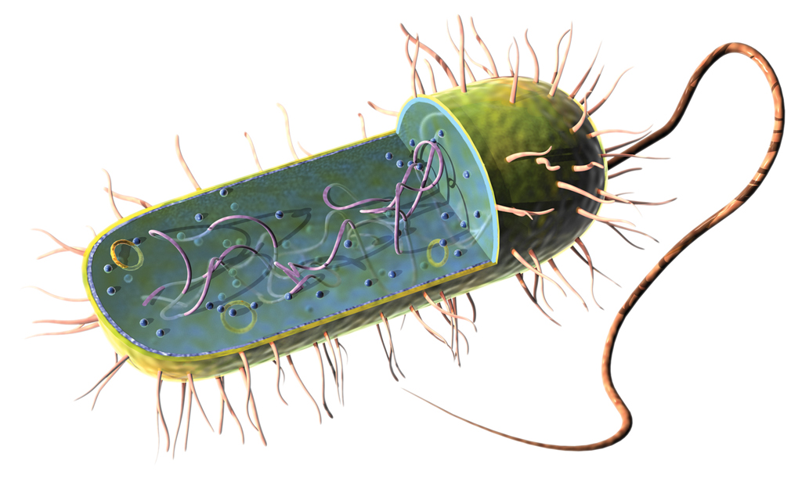
Bacteria and archaea have similar structures.
plasmid
flagellum
pili
pili
plasma membrance
flagellum
chromosome
cell wall
plasmid
This diagram shows the typical structure of a prokaryote. Archaea and bacteria look very similar, although they have important molecular differences.

Slide 6
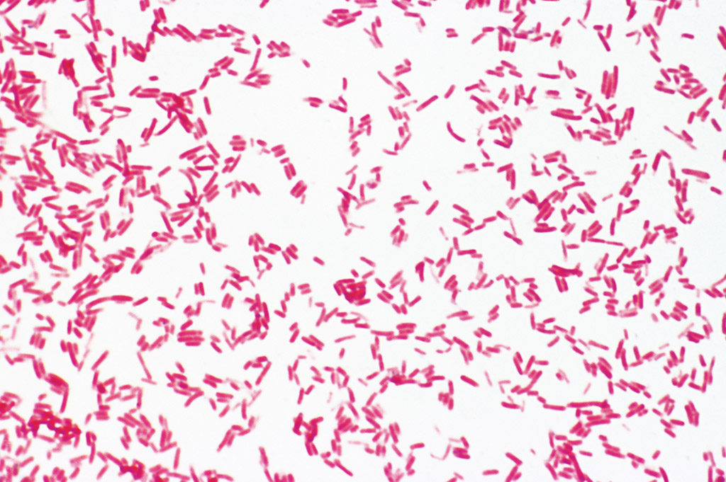
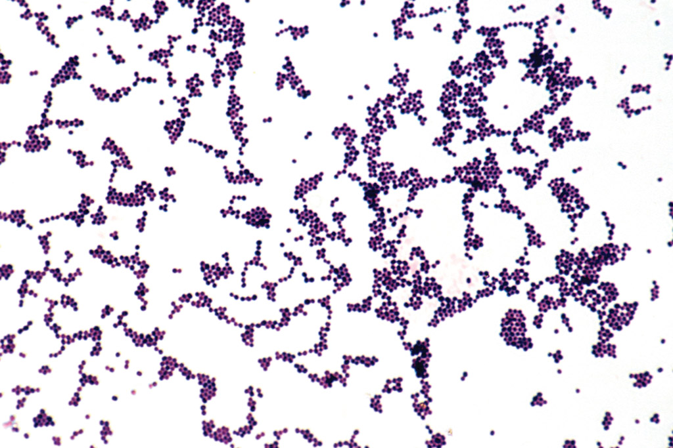
Gram staining identifies bacteria.
stains polymer peptidoglycan
gram-positive stains purple, more peptidoglycan
gram-negative stains pink, less peptidoglycan
Gram-negative bacteria have a thin layer of peptidoglycan and stain red.
Gram-positive bacteria have a thicker peptidoglycan layer and stain purple.

Slide 7
3. How they get their energy
Heterotrophs: get energy by decomposing other organisms.
Photosynthetic Autotrophs: make their own energy by converting sunlight into food.
Chemosynthetic autotrophs: make their own energy by using chemicals around them. (important in agriculture: change nitrogen into a form we can use to make proteins in our bodies)

Slide 8
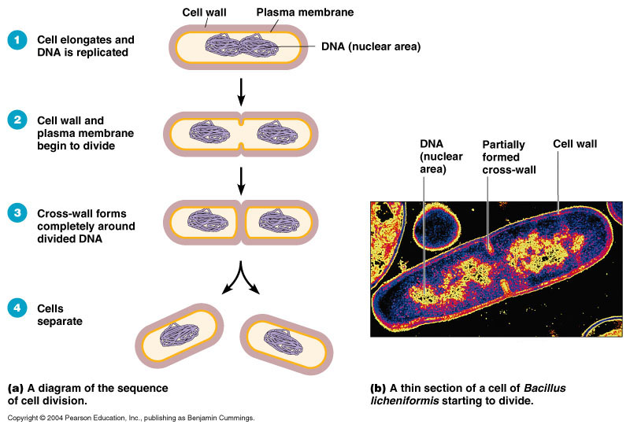
Binary Fission

Slide 9
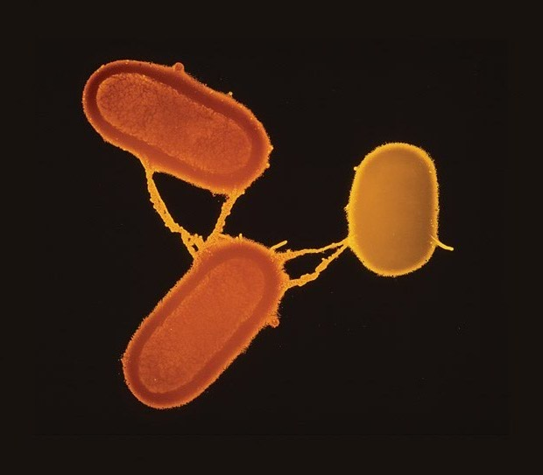
Bacteria have various strategies for survival.
Prokaryotes exchange genes during conjugation → swap DNA.
conjugation bridge
Bacteria may survive by forming endospores → a protective spore that allows the bacterium to survive harsh external environments .
TEM; magnification 6000x

